Slide 1

Oracle 11g: SQL
Chapter 1 Addendum
Transforming ERD’s into Relations

Slide 2
Objectives
Translate the conceptual data model of an ERD into a logical relational design that can be implemented on a chosen DBMS
Oracle 11g: SQL

Slide 3
Transforming ERD’s to Relations
Entities
Relations
Foreign Keys
New Relations
Relationships
Order of attack for mapping
Regular Entities
Weak Entities
Binary Relationships
Associative Entities
Unary Relationships
Ternary (n-ary) Relationships
Supertype / Subtype Relationships

Slide 4
Regular Entities
Each entity becomes a relation (same name)
Each simple attribute becomes a column
Identifier of entity becomes primary key
Prod_ID
Prod_Name
Unit_Price
PRODUCT
Notes:
PRODUCT(Prod_ID, Prod_Name, Unit_Price)

Slide 5
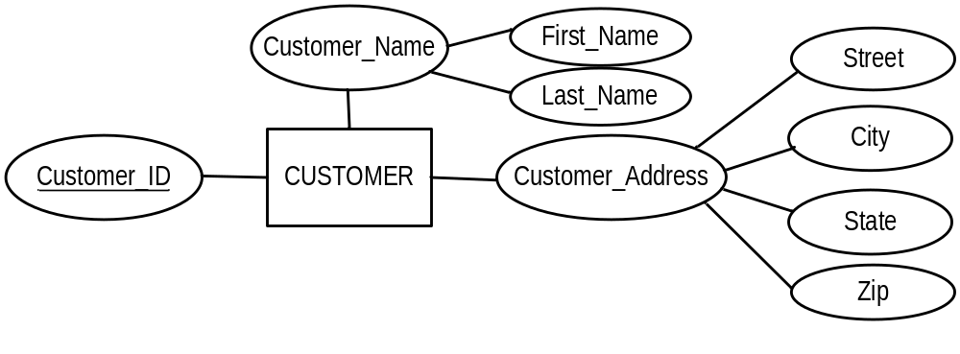
Regular Entities
Composite attributes only have their simple component attributes become columns
Notes:
CUSTOMER ( Customer_ID, First_Name, Last_Name, Street, City, State, Zip )

Slide 6
Regular Entities
Multi-valued attributes become a separate relation containing
  The key of the original (as a foreign key)
  The repeating attribute (to make a unique key)
Employee_ID
Skill
EMPLOYEE
Notes:
EMPLOYEE (Employee_ID, …)
EMPLOYEE_SKILL (Employee_ID, Skill)

Slide 7
Weak Entities
Weak entity becomes a relation
Primary key of owner relation becomes a foreign key
Primary key of new relation is combination of owner primary key plus a surrogate partial identifier

Slide 8
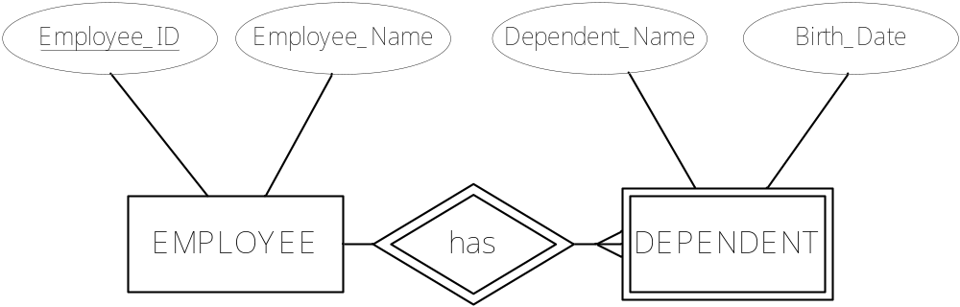
Weak Entities
Notes:
EMPLOYEE (Employee_ID, Employee_Name, … )
DEPENDENT (Employee_ID, Dependent_ID, Dependent_Name, Birth_Date, … )

Slide 9
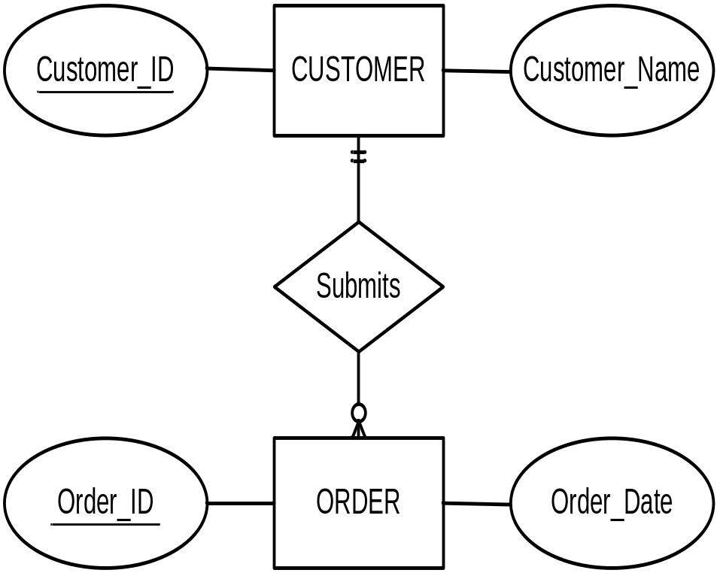
Binary Relationships
One-to-Many (1:M)
Create relation for each of the entities
Include primary key of entity on one side as foreign key in relation on many side
Notes:
CUSTOMER ( Customer_ID, Customer_Name, … )
ORDER ( Order_ID, Order_Date, Customer_ID, … )

Slide 10
Binary Relationships
One-to-One (1:1)
Create relation for each of the entities
Include primary key of entity on the mandatory side as a foreign key in relation on the optional side
Raffle
Ticket
Prize
Notes:
TICKET ( Ticket_Nbr, Name, Address, … )
PRIZE ( Prize_Nbr, Prize_Amount, Ticket_Nbr )

Slide 11
Binary Relationships
Many-to-Many (M:N)
Create relation for each of the entities
Create new relation for the relationship, containing the primary key of each parent plus any other attributes
Primary key of new relation is combination of both parent keys

Slide 12
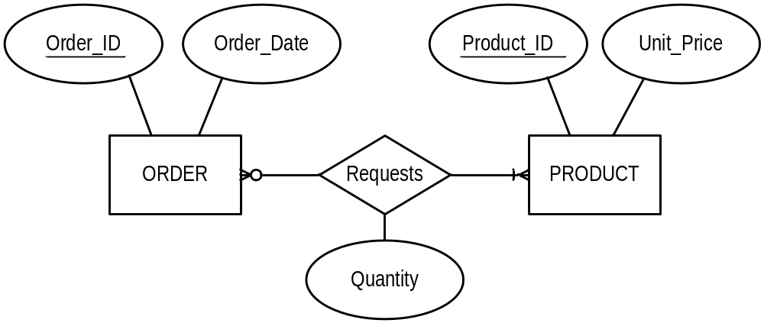
Binary Relationships
Many-to-Many (M:N)
Notes:
ORDER (Order_ID, Order_Date, … )
PRODUCT (Product_ID, Unit_Price, … )
ORDER_LINE or ORDER_PRODUCT ( Order_ID, Product_ID, Quantity )

Slide 13
Associative Entities
Same process as M:N relation
  In practice, should always create the Associative Entity in your ERD to eliminate the M:N
Often has own (surrogate) key, particularly for relating to real world

Slide 14
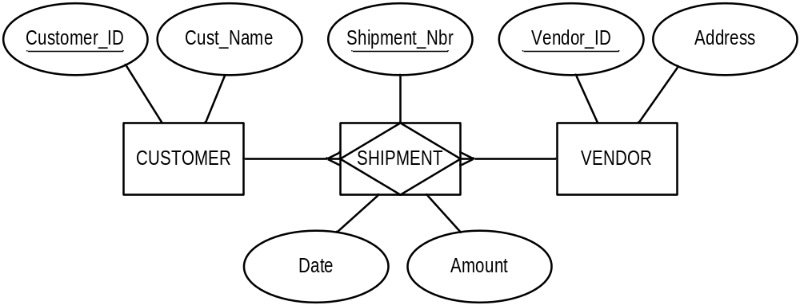
Associative Entities
Notes:
CUSTOMER ( Customer_ID, Name, … )
VENDOR ( Vendor_ID, Address, … )
SHIPMENT ( Shipment_Nbr, Customer_ID, Vendor_ID, Date, Amount )
Note that Customer_ID + Vendor_ID + Date may give another unique key, just not the primary

Slide 15
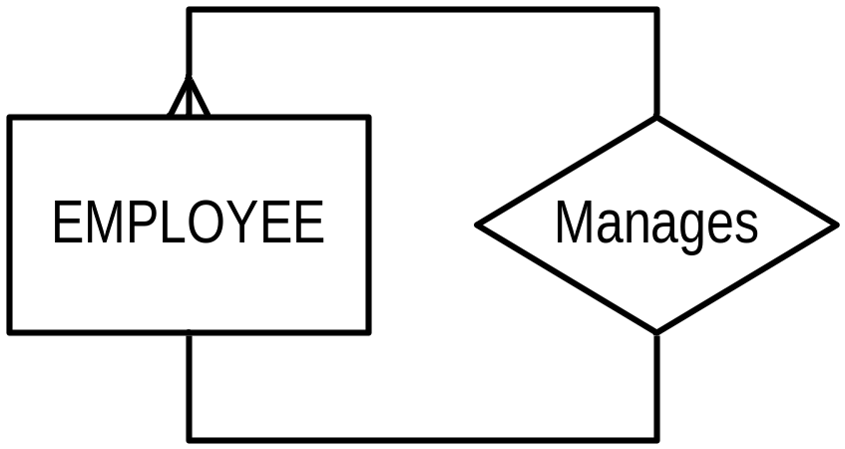
Unary Relationships
One-to-Many (1:M)
Create relation for the entity
A foreign key is added within the same relation that references its own primary key
Notes:
Recursive Foreign Key - same for 1:1
EMPLOYEE ( Employee_ID, Name, … , Manager_ID )
Manager_ID and Employee_ID are from the same domain

Slide 16
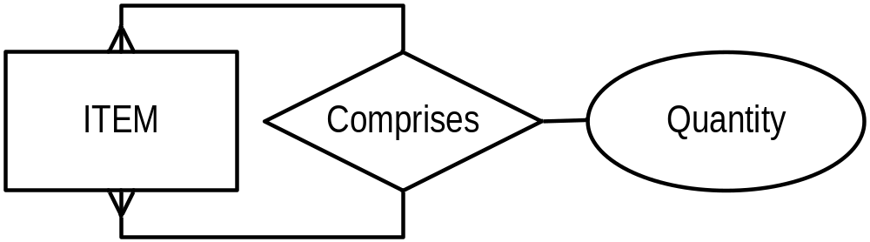
Unary Relationships
Many-to-Many (M:N) – Bill of Materials
Create relation for the entity
Create new relation for relationship with primary key consisting of 2 different foreign keys to the original relation
Notes:
ITEM ( Item_Nbr, Item_Name, … )
COMPONENT ( Item_Nbr, Component_Nbr, Quantity )
Note Component_Nbr and Item_Nbr are from same domain

Slide 17
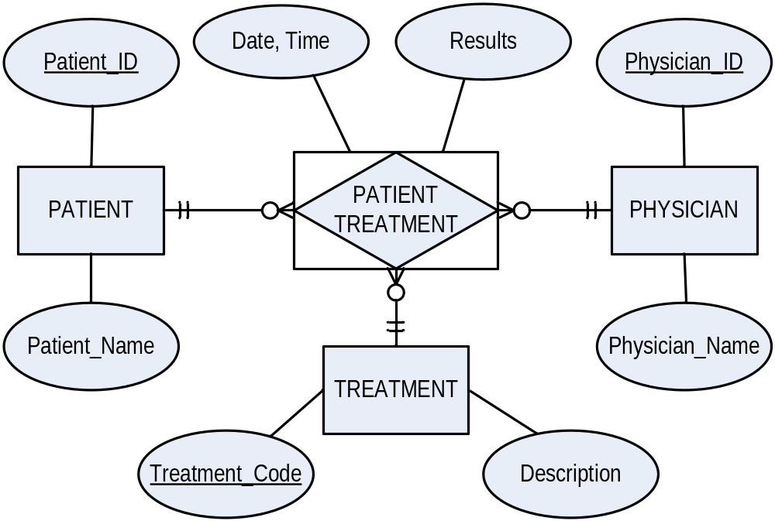
Ternary Relationships
Convert to Associative Entity (3 foreign keys)
Notes:
PATIENT ( Patient_ID, Patient_Name, … )
PHYSICIAN ( Physician_ID, Physician_Name, … )
TREATMENT ( Treatment_Code, Description )
PATIENT_TREATMENT ( Patient_Treatment_Nbr, Patient_ID, Physician_ID, Treatment_Code, Date, Time, Results )
Note: second unique key is Patient_ID + Physician_ID + Treatment_Code + Date + Time

Slide 18
Supertype / Subtype
In data modelling, a supertype is a general case and a subtype is a more specific case
Create separate relation for supertype and each subtype
Put all common attributes in the supertype (including primary key)
Put unique attributes in applicable subtype
Assign an attribute in supertype to function as the subtype discriminator
Notes:
Eg. Doctor vs ( Surgeon, Dentist, Paediatrician, … )
Eg. TRU Employee vs ( Faculty, CUPE Staff, Administrator )

Slide 19
Supertype / Subtype
Name
Address
Employee_No
EMPLOYEE
Employee_Type
“H”
“C”
“S”
HOURLY
EMPLOYEE
SALARIED
EMPLOYEE
CONSULTANT
Annual_Salary
Billing_Rate
Hourly_Wage
Notes:
EMPLOYEE (Employee_No, Employee_Type, Name, Address, … )
HOURLY_EMPLOYEE (Employee_No, Hourly_Rate)
SALARIED_EMPLOYEE (Employee_No, Annual_Salary)
CONSULTANT (Employee_No, Billing_Rate)

Slide 20
Supertype / Subtype
Total specialization
Partial specialization
Disjoint
Overlapping
Notes:
Total specialization = each instance of supertype MUST be a member of some subtype (double line)
Partial specialization = an instance of supertype may not be a member of any subtype (single line)
Disjoint = an instance can be in only one subtype (d in circle)
Overlapping = an instance can be in more than one subtype (o in circle)

Slide 21
